Slide 1
Linear Regression
Shaurya Singhal
Anshu Kumar

Slide 2
Types of ML
Supervised Learning
Unsupervised Learning
Reinforcement Learning
Supervised Learning
SuperVised Learning

Slide 3
Univariate linear regression focuses on determining relationship between one independent variable(X) and one dependent variable(Y).
Univariate Linear Regression
X(CGPA)
7.8
9.4
8.8
8.3
7.3
…..
Label(Y) (Number of hrs. study)
6.6
12
10
9.5
6
…..

Slide 4
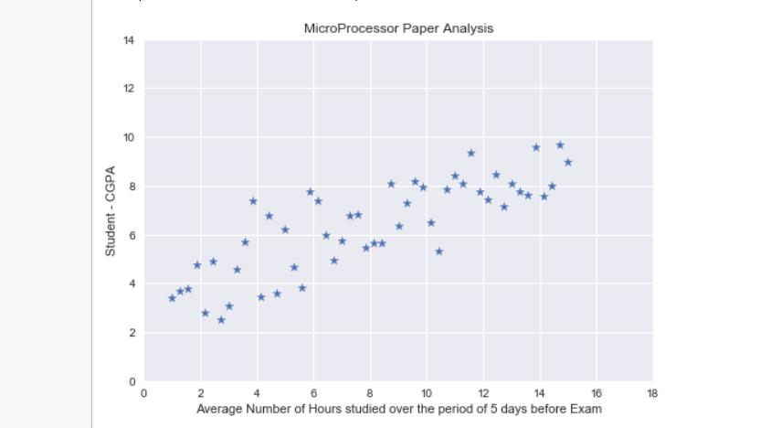
Dataset
Focus : - CGPA Vs Hours of Study(Not Attendence)

Slide 5
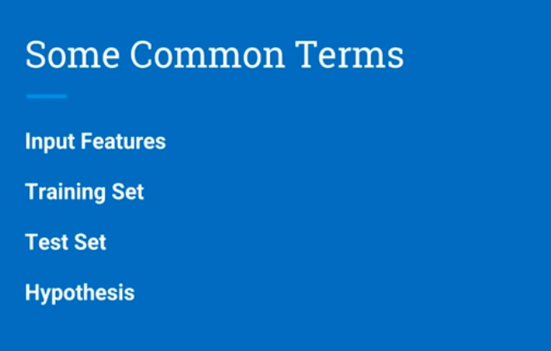

Slide 6
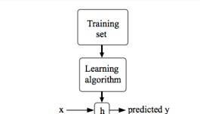

Slide 7
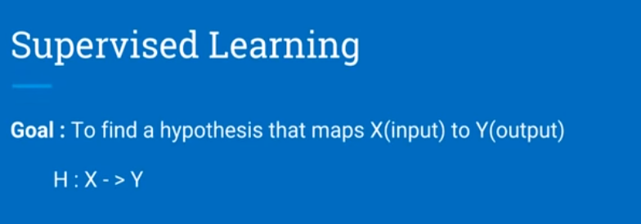

Slide 8
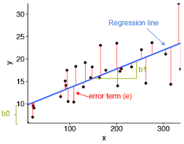
Q - How to find line(hypothesis)?
Q - What is the measure of finding Best line ?
Ans - Error Function (How?)

Slide 9

Choice of Error Function
1.
-ve and +ve error added up

Slide 10

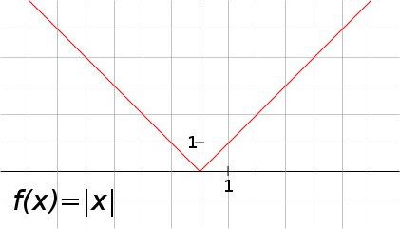
2.
Non-differentiable at (Ypred == Yactual)

Slide 11

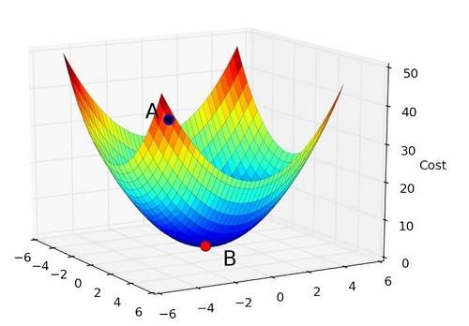
3.
Perfect, and this function is Convex in Nature(Helpful)

Slide 12
Goal - Minimizing the Error Function
An Iterative method to move toward the minimum point(using Gradient).
Gradient descent is an optimization algorithm used to minimize some function by iteratively moving in the direction of steepest descent as defined by the negative of the gradient. In machine learning, we use gradient descent to update the parameters of our model.
Gradient Descent

Slide 13
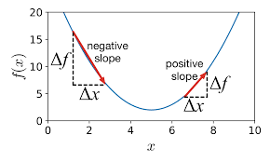

Slide 14

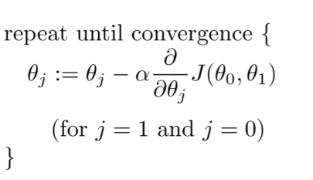
Updation Rule

Slide 15
Convergence Criteria
Number of Iteration
Change in Error

Slide 16
Let’s See the code (Working!)
Visualizing Line(Hypothesis)
Behaviour of Error Function using no. of iteration, change in error.
Learning rate Variation
Visualizing Convex Function

